Slide 1
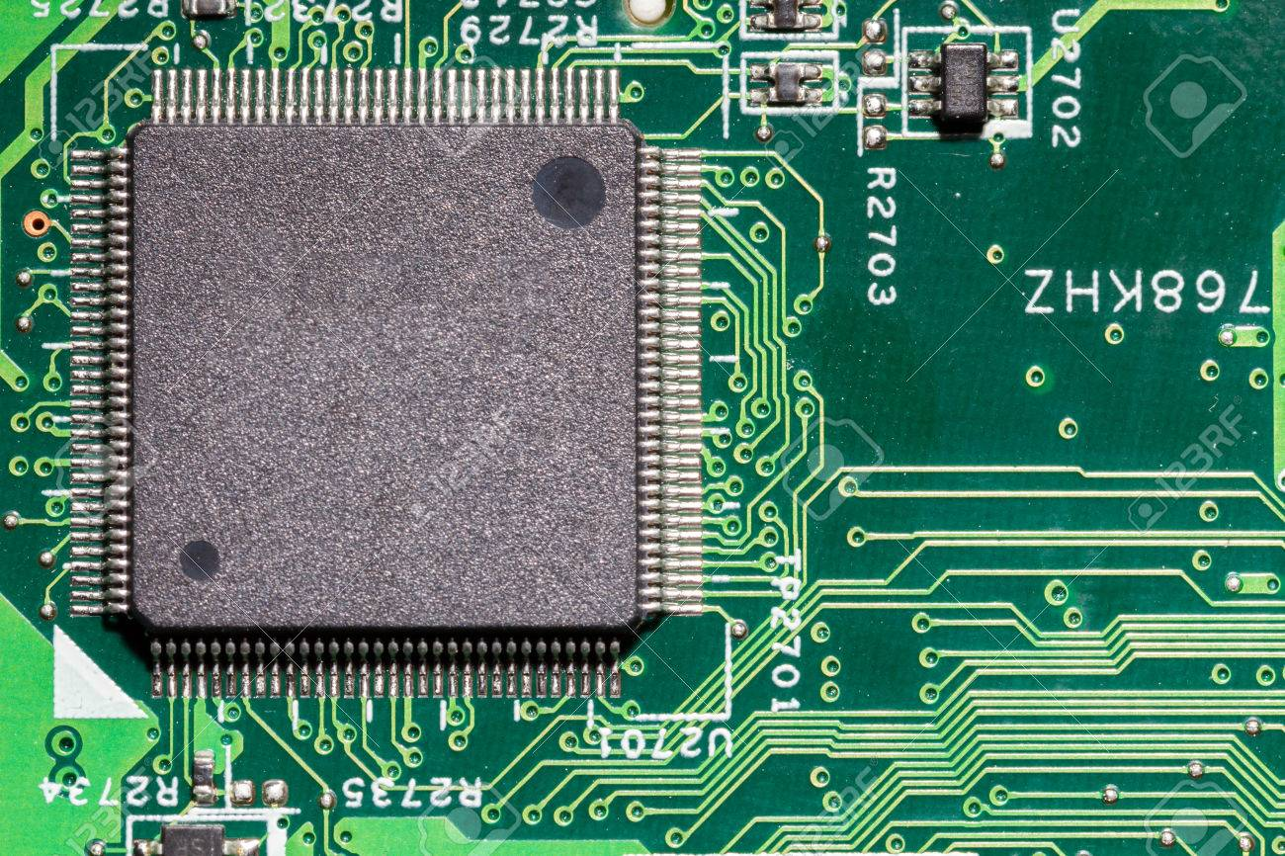
Chips & Circuits
Eline van Groningen
Mimoun Boulfich
Syrka van Kuppenveld
Minor Programming – June 2020

Slide 2
Overview
Introduction
Methods
Results
Conclusion
Discussion
Future Approach

Slide 3
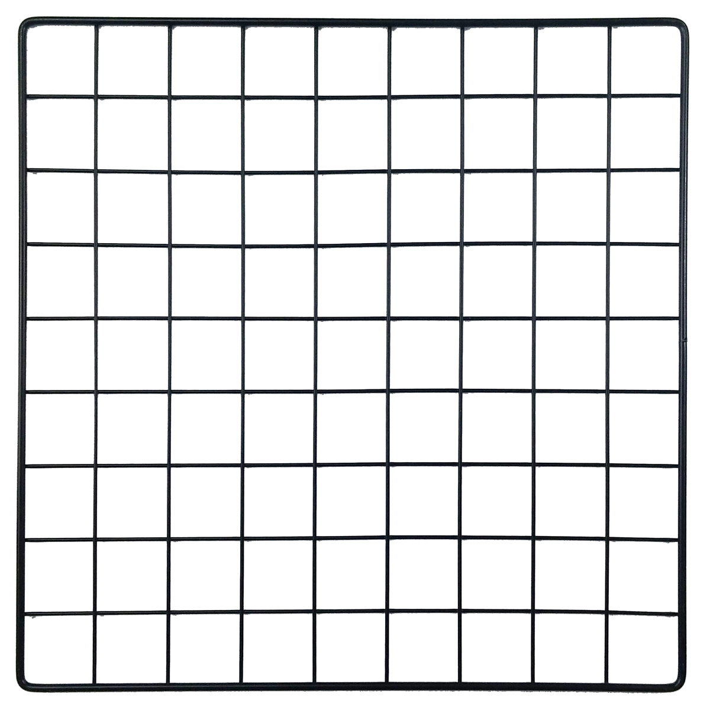
Introduction – Case
Wiring problem only
Constraint optimization problem (COP)
Constraints
Netlist = list of connectable gates (2D)
Collision → circuit cannot be used (=hard)
Intersection → minimalize (=soft)
= gate (fixed)
A
B
= wire
C
Netlist (2D)
A
B
E
D
B
C
C
D
Chip
Collision!
Intersection
D
E
E
A
Notes:
Gates zijn fixed

Slide 4
Introduction – Case
Objectives:
Length wire
Longer wire -> higher costs
Intersection
Intersection -> higher costs
Sub goals
Minimalize length wire
Minimalize intersections
= gate (fixed)
= wire
Chip
Notes:
Gates zijn fixed

Slide 5
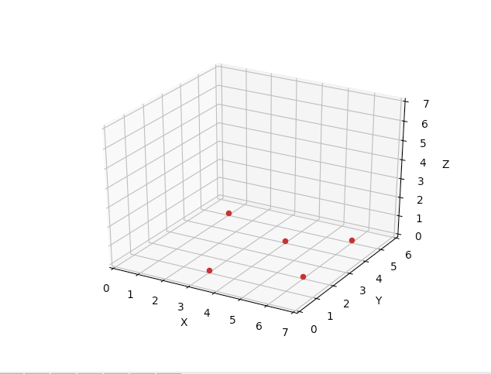
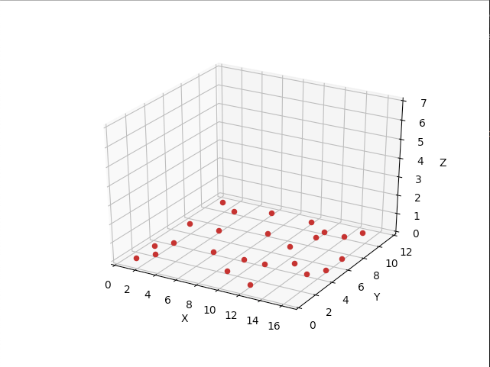
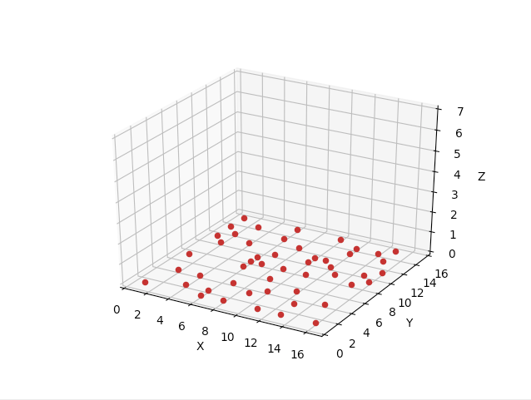
Introduction – Case
7 Layers​
+​
Base Layer
Chip_0
Chip_1
Chip_2
A
B
A
B
A
B
Netlist_1: 5x
Netlist_2: 7x
Netlist_3: 10x
Netlist_4: 30x
Netlist_5: 40x
Netlist_6: 50x
Netlist_7: 50x
Netlist_8: 60x
Netlist_9: 70x
Notes:
Per chip: toename gates:
Per netlist: toename nets:
Heuristiek: beginnen met gates die veel connecties hebben = social map > max

Slide 6
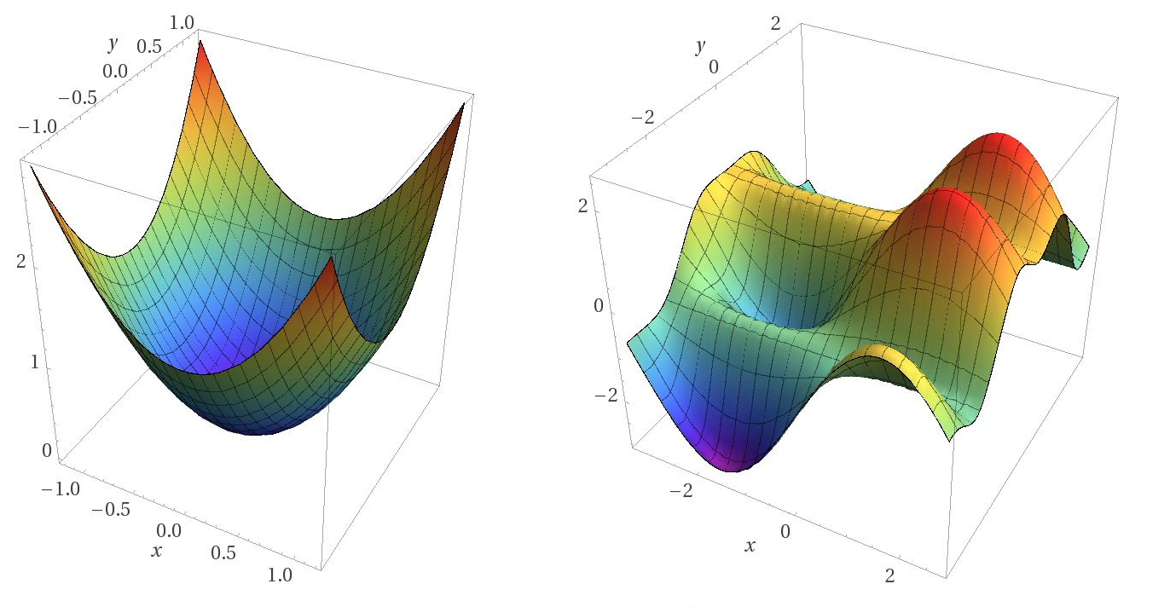
Introduction – Objective Function
C = n + 300 • k
with:
C = cost
n = number of unit-lengths wires
k = number of intersections
MINIMISATION
?
Cost
nr. intersections
length
Notes:
Gates zijn fixed

Slide 7
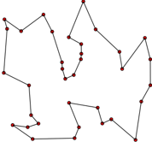
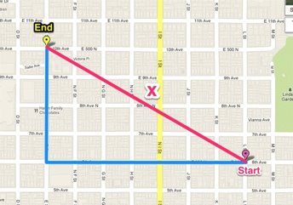
Introduction – Objective function
Lower bound​
With n connections:​
Compute wire lengths (= s) of all connections in netlist (Manhattan distance)
Lower bound = Σ n manhattan distances = s₁ + s₂ + s₃ + … + s_{n}
Traveling salesman
Manhattan Distance
Notes:
Gates zijn fixed

Slide 8
Introduction – Objective function
Chip | Netlist | Lowerbound Cost
0 | 1 | 20
 | 2 | 35
 | 3 | 48
1 | 4 | 291
 | 5 | 341
 | 6 | 475
2 | 7 | 600
 | 8 | 578
 | 9 | 761
Notes:
Gates zijn fixed

Slide 9
Introduction – State Space
1) W.r.t. Implementation order Nets (gate-connections)
2) W.r.t. Construction of paths
Notes:
Gates zijn fixed

Slide 10
Introduction – State Space
1) W.r.t. Implementation order Nets (gate-connections)
General formula: nr of possible states = nr. of nets ! (factorial)
Examples
Chip 0, netlist 1
5 nets
Possibilities = 5! = 5 • 4 • 3 • 2 • 1 = 120 states
Chip 2, netlist 9
70 nets
Possibilities = 70! = 1,2 • 10¹⁰⁰ states
A
B
C
E
D
Notes:
Gates zijn fixed

Slide 11

Introduction – State Space
2) W.r.t. Construction of paths (lower bound: Usage Manhattan distance)
General formula
Per path: steps Manhattan x-dimension • steps Manhattan y-dimension
Total = path state spaces
Example
Chip 0, Netlist 1
Manhattan distances
x, y
A > B = 5, 0 = 5 • 0 > 1 possibility
B > C = 1, 2 = 1 • 2 > 2 possibilities
C > D = 1, 4 = 1 • 4 > 4 possibilities
D > E = 3, 1 = 3 • 1 > 3 possibilities
E > A = 2, 5 = 2 • 5 > 10 possibilities
A
B
C
Possible states = 1 • 2 • 4 • 3 • 10 = 240
E
D
Notes:
Gates zijn fixed

Slide 12
Introduction – State Space
2) W.r.t. Construction of paths (upper bound)
Start
(x, y, z)
Branching factor = 6
Start
(5, 5, 5)
Branching factor = 3
(x, y, z)
Put: chip 10 x 10 x 10
(0, 0, 0)
x + 1
x - 1
y + 1
y - 1
z + 1
z - 1
(6, 5, 5)
(4, 5, 5)
(5, 6, 5)
(5, 4, 5)
(5, 5, 6)
(5, 5, 4)
...
...
...
x + 1
y + 1
z + 1
...
...
...
...
...
(1, 0, 0)
(0, 1, 0)
(0, 0, 1)
x + 1
x - 1
y + 1
y - 1
z + 1
z - 1
y + 1
z + 1
x + 1
y + 1
z + 1
x + 1
y + 1
z + 1
(6, 5, 4)
(4, 5, 4)
(5, 6, 4)
(5, 4, 4)
(5, 5, 5)
(5, 5, 3)
x + 1
...
...
...
(2, 0, 0)
(1, 1, 0)
(1, 0, 1)
(1, 1, 0)
(0, 2, 0)
(0, 1, 1)
(1, 0, 1)
(0, 1, 1)
(0, 0, 2)
...
...
...
...
...
x + 1
x - 1
y + 1
y - 1
z + 1
z - 1
...
...
...
...
...
...
...
...
...
...
...
...
...
...
...
...
...
...
(6, 5, 3)
(4, 5, 3)
(5, 6, 3)
(5, 4, 3)
(5, 5, 4)
(5, 5, 2)
Notes:
Gates zijn fixed

Slide 13
Introduction – State Space
2) W.r.t. Construction of paths (upper bound)
General formula:
State space = (max nr of steps • max nr of neighbouring coordinates)^{no. of nets}
= Branching factor
Example
Chip 0, netlist 1
Max nr of steps needed = 50% all possible steps on the grid
Max nr of neighbours = 6
No. of nets = 5
Possibilities = (511 • 6)⁵ = 2,7 • 10¹⁷ states
Notes:
Gates zijn fixed

Slide 14
Introduction – State Space
1) W.r.t. Implementation order Nets (gate-connections)
2) W.r.t. Construction of paths
State space = Statespace₂₎
Lower bound
Upper bound
Example smallest chip: Chip 0, netlist 1
2) Possible states = 240
State space = 240 states
Example smallest chip: Chip 0, netlist 1
2) Possible states = 2,7 • 10¹⁷
State space = 2,7 • 10¹⁷ states
Notes:
Gates zijn fixed

Slide 15
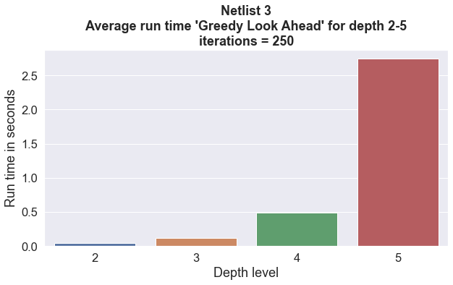
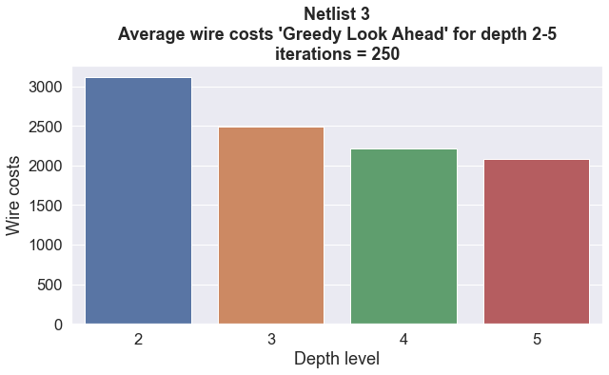
Method - Algorithm – Greedy
Greedy element
Next position based on shortest Manhattan Distance.
Random element
If multiple equal the shortest distance, one of these is randomly selected​.
Order in which connections are made.
Look ahead
Depth = 4
Notes:
Gates zijn fixed

Slide 16
Method - Algorithms – Heuristics
Order connections
Social Map
Gates ordered based on density within a pre-specified radius.
Radius = 3
Density = no. of gates within radius
Order from max to min density.
Wire path
Sky Is The Limit
Higher costs for staying on bottom layers if the Manhattan Distance between the position and the goal gate is larger than 4.
Wire Can’t Touch This
Intersection as hard constraint.
Notes:
Gates zijn fixed

Slide 17
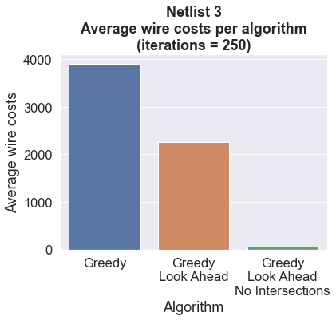
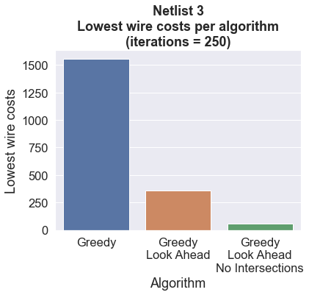
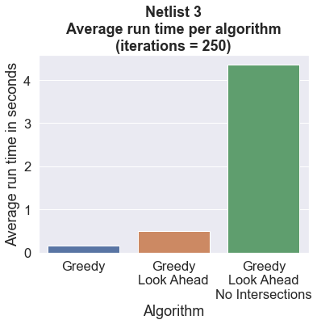
Results – Chip 0 – Algorithms compared
Notes:
Gates zijn fixed

Slide 18
Results – Chip 0 – Algorithms compared
Netlist | Lower bound objective function | Greedy Look Ahead No Intersections mean costs | Greedy Look Ahead No Intersections min costs
1 | 20 | 20.496 | 20
2 | 35 | 44.488 | 39
3 | 48 | 65.528 | 58
Notes:
Gates zijn fixed

Slide 19
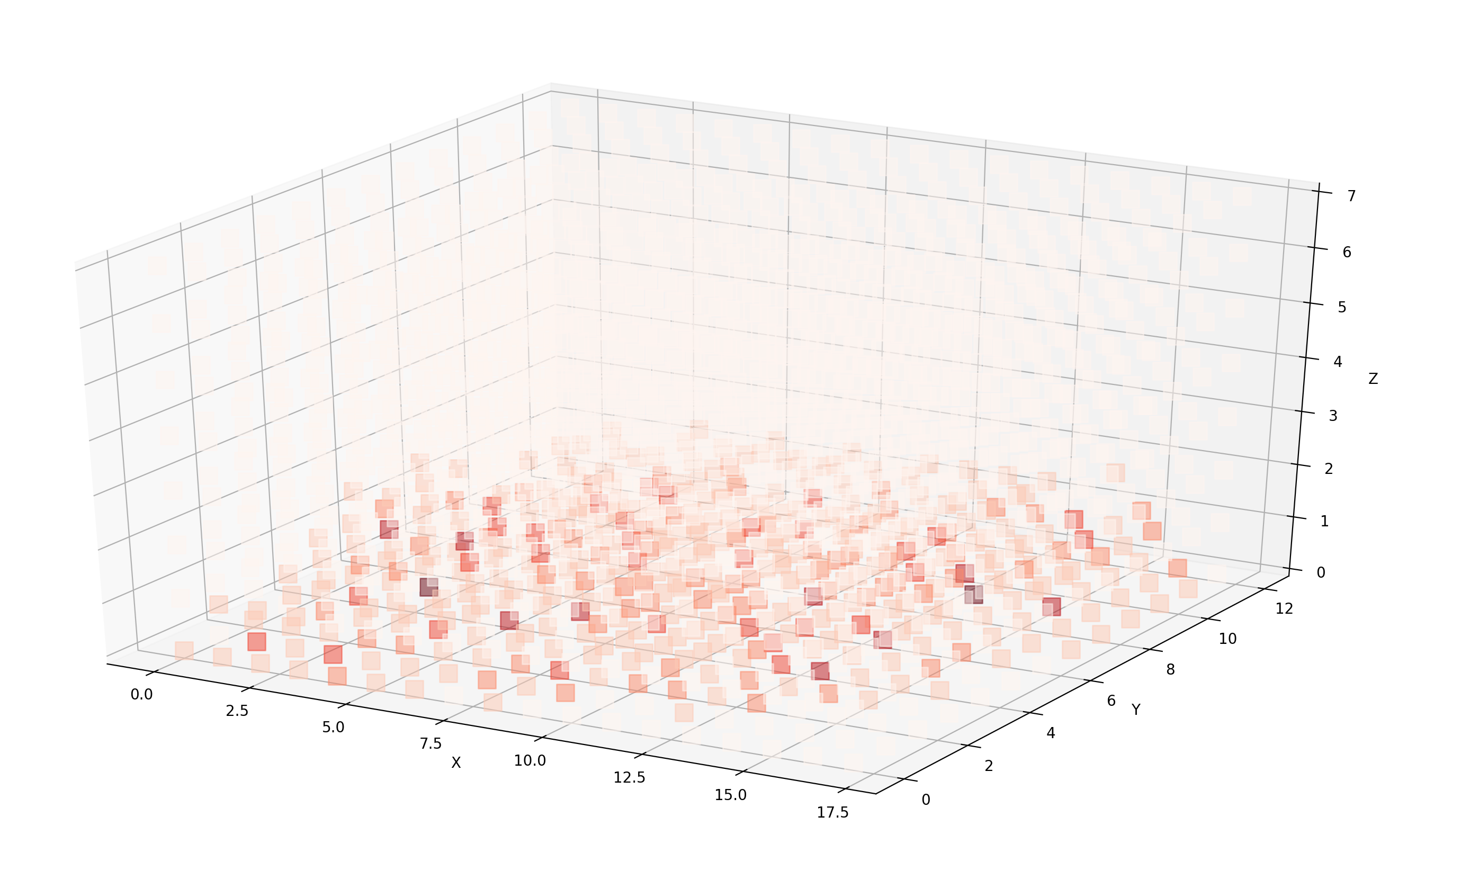
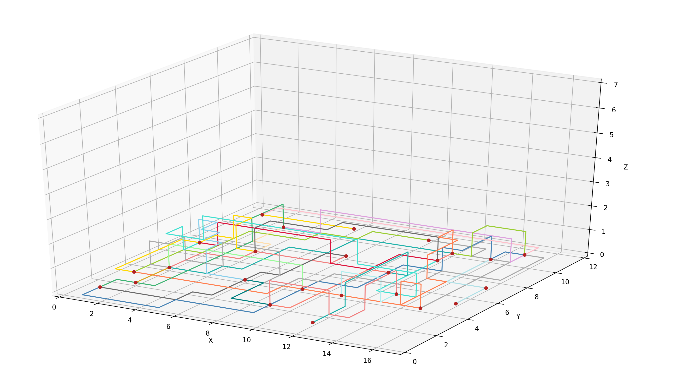
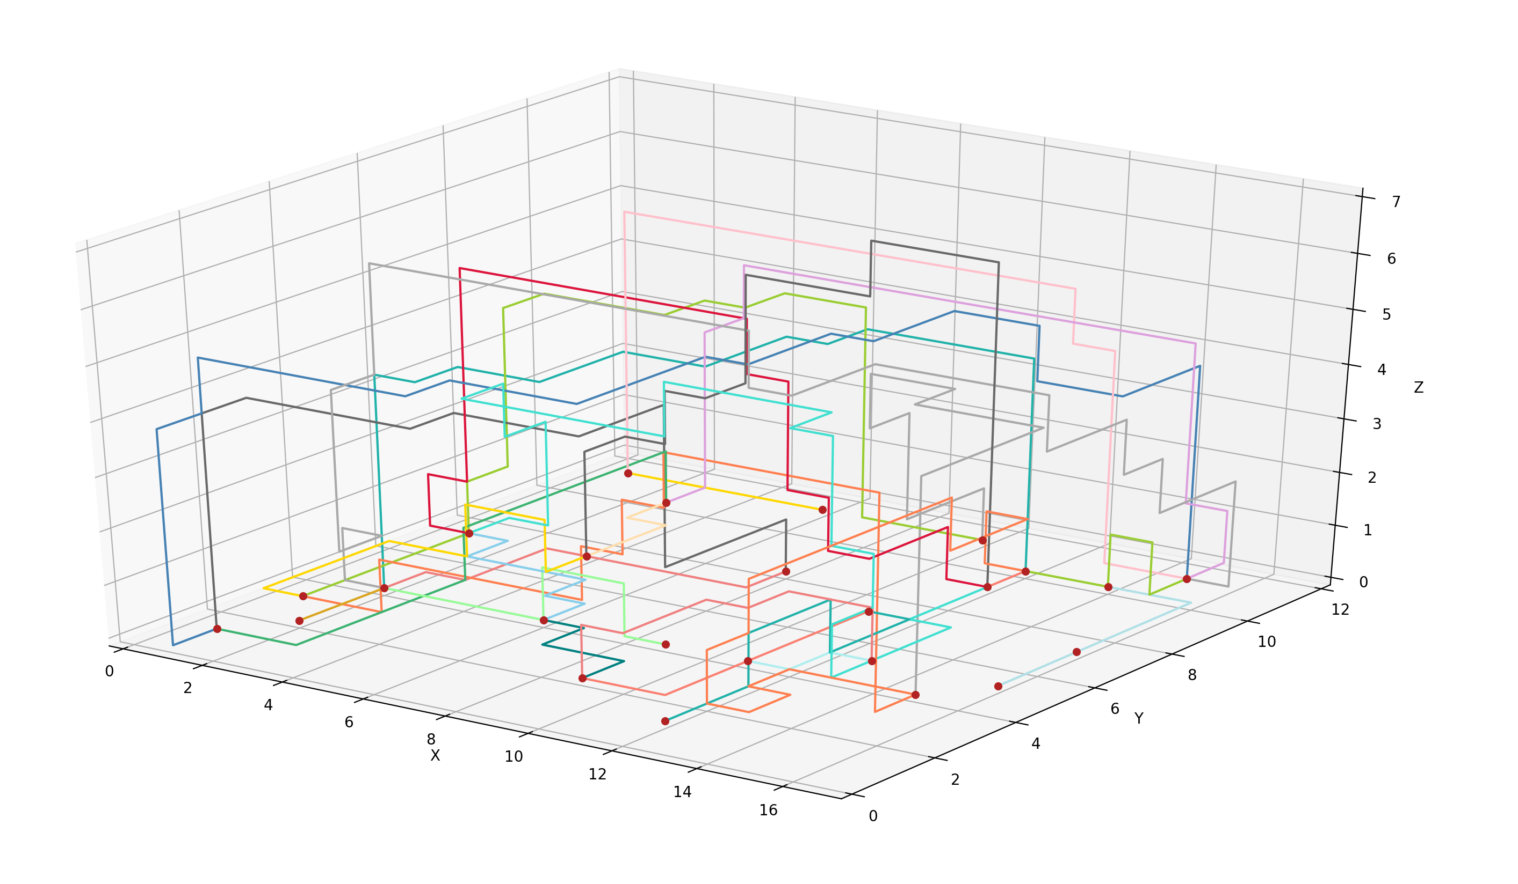
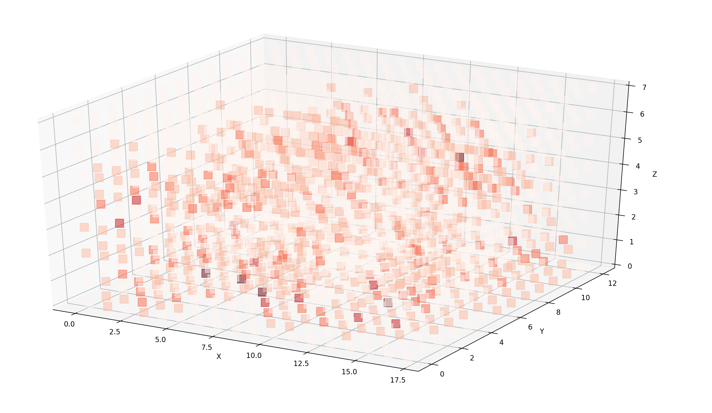
Introduction – State Space
Netlist 4
Greedy Look Ahead
Wire costs = 20445
Netlist 4
Greedy Costs
Wire costs = 9143
Lowerbound objective function = 291
Notes:
Gates zijn fixed

Slide 20
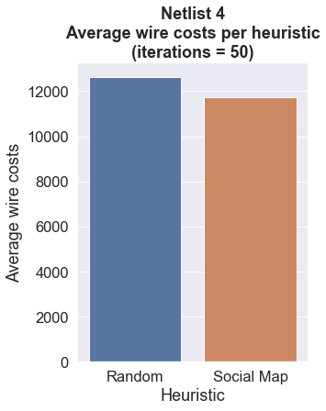
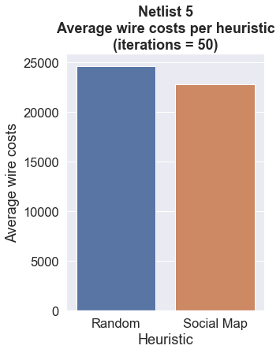
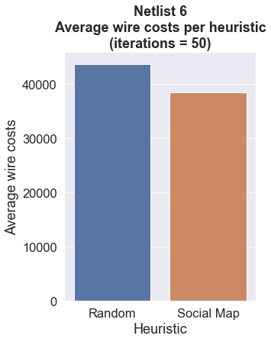
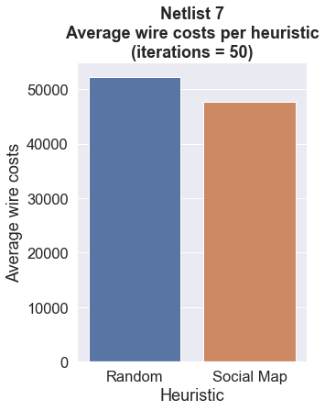
Results – Greedy Costs
Lowerbound = 291
Lowerbound = 341
Lowerbound = 475
Lowerbound = 600
Notes:
Gates zijn fixed

Slide 21
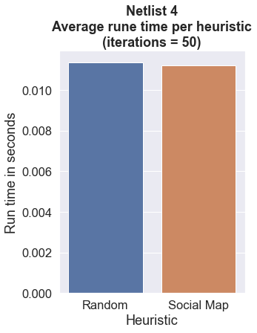
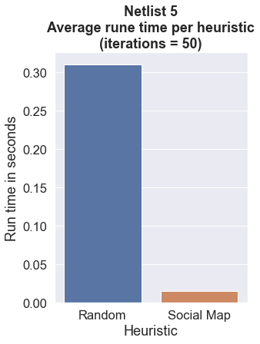
Results – Greedy Costs
Notes:
Gates zijn fixed

Slide 22
Discussion
Greedy – Manhattan Distance​
Biased to not move up the grid (z-axis)
Moving up on the z-axis always increases the distance​
Limitation for Greedy and Greedy Look Ahead​
Results up to netlist 4​
Heuristic – 'Sky Is The Limit' ​
Increases costs for not moving up the z-axis ​
Results up to netlist 7
Can be combined with heuristics for gate/connection order
Social Map
Heuristic – ‘Social Map’
Lowers costs when compared to random, however, difference is relatively small
Lower run time when compared to random
Notes:
Gates zijn fixed

Slide 23
Conclusion
Chip 0
Netlist 1-3 → Greedy Look Ahead with ‘Can’t Touch This’
Chip 1 & 2
Netlist 4-7 → Greedy with ‘Sky Is The Limit’ combined with Social Map
Notes:
Gates zijn fixed

Slide 24
Future Approach
Sky is the limit​
Research on cost distribution layers​
1) Sky is the limit + 2) Wire can't touch this​
1) Increased costs for steps on bottom layers​
2) Intersections as a hard constraint
Notes:
Gates zijn fixed

Slide 26
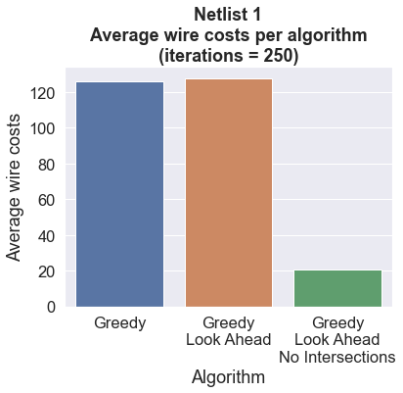
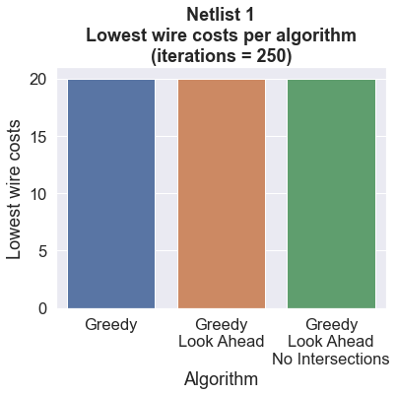
Results – Algorithms Compared – Netlist 1
Notes:
Gates zijn fixed

Slide 27
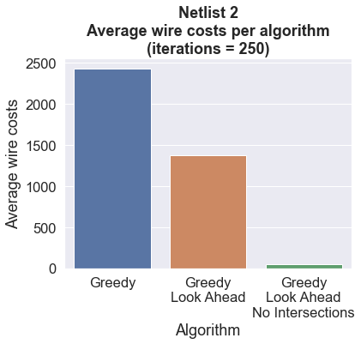
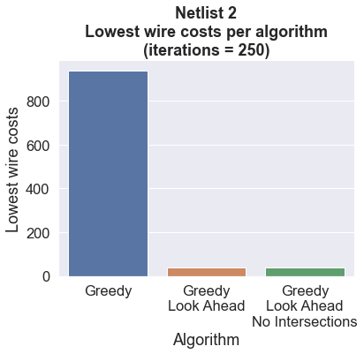
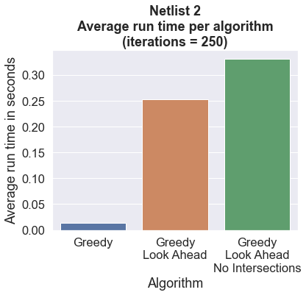
Results – Algorithms Compared – Netlist 2
Notes:
Gates zijn fixed

Slide 28
Algorithms - Random
Random element
Next position
Order in which connections are made
Restart if wire gets stuck
Results → run time
Netlist 1 and 2
Notes:
Gates zijn fixed

Slide 29
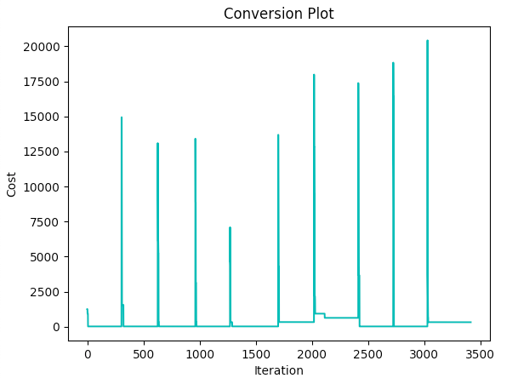
Algorithms - Hillclimber
Best wire costs
no. 0 = 20
no. 1 = 20
no. 2 = 20
no. 3 = 20
no. 4 = 20
no. 5 = 328
no. 6 = 630
no. 7 = 20
no. 8 = 20
no. 9 = 320
Overall best wire costs = 20
Time: ± 40 min.
Start state
Random algorithm
Random adjustment
Choice of path to be rebuilt
Building path
Inheritance Greedy Look Ahead
Netlist 1
Notes:
Gates zijn fixed

